Slide 1

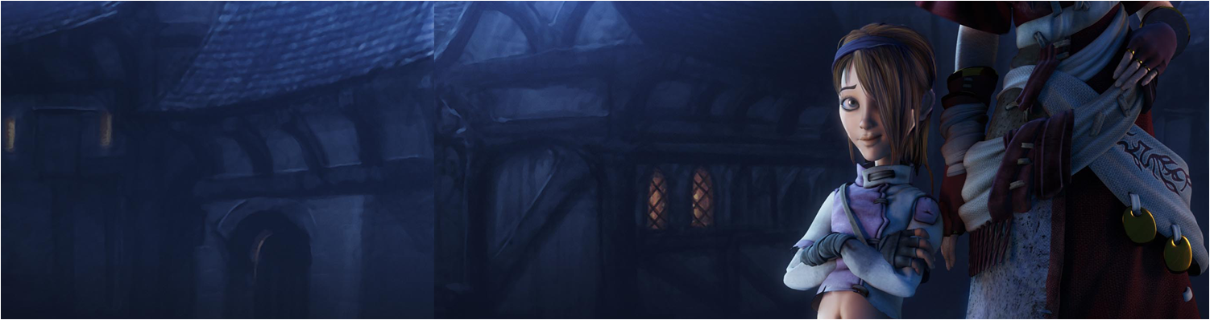

Lecture 3: Creating & Curating Portfolios
GAM340: Professional Practice
BA(Hons) Game Development

Slide 2
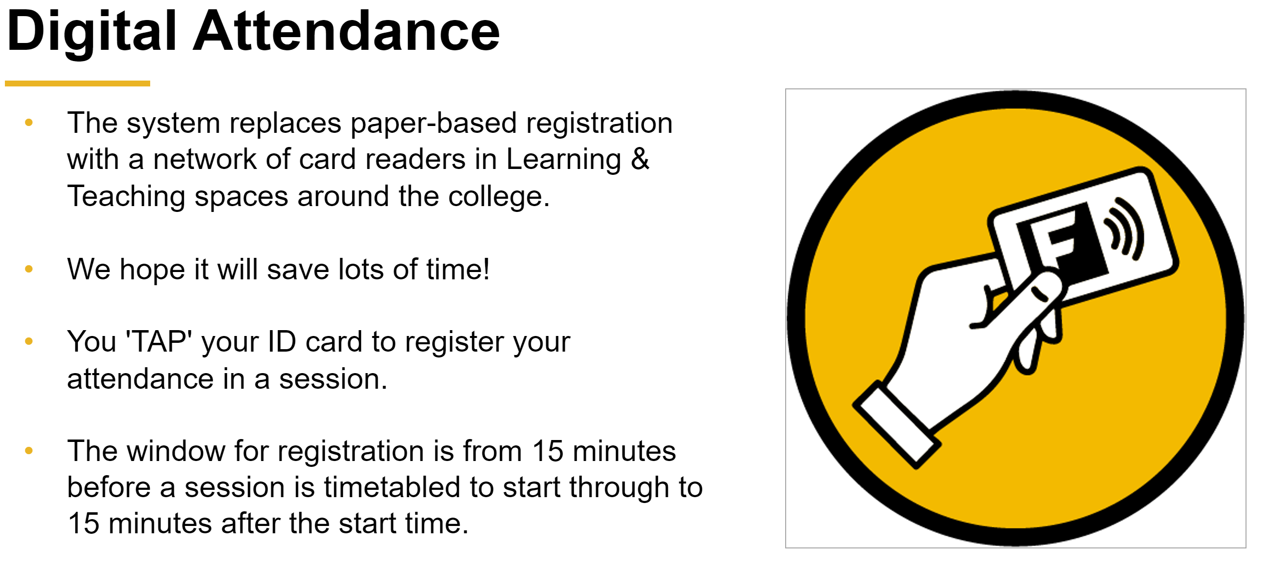

Slide 3
Learning Outcomes
Define the key attributes for a successful portfolio for your chosen route(s)
Create rough outlines to describe the look, feel and content of your desired portfolio

Slide 4
But first …
A few people asked me about imposter syndrome

Slide 5
But first …
Lets start with a definition
Impostor syndrome (also known as impostor phenomenon, impostorism,
fraud syndrome or the impostor experience) is a psychological pattern in which an individual doubts their accomplishments and has a persistent
internalized fear of being exposed as a "fraud".
Langford, J; Clance, P (Fall 1993). "The impostor phenomenon: recent research findings regarding dynamics, personality and family patterns and their implications for treatment"
Psychotherapy: Theory, Research, Practice, Training. 30 (3): 495–501. doi:10.1037/0033-3204.30.3.495

Slide 6
Dealing with Imposter Syndrome
In games development:
A feeling that you’re not in a position on merit
A feeling that you know nothing about the work you are being expected to do
A feeling that everyone else knows your job better than you do
A feeling that you will be found out and sacked

Slide 7
Dealing with Imposter Syndrome
In games development:
You may have had this already in your experiences at School, College and University
People in your group are a lot better than you
People in lower year groups are better than you

Slide 8
Dealing with Imposter Syndrome
In games development:
From my games experience:
1. Working at Sony
2. Going to Lionhead
3. Freelancing on Might & Magic
4. Freelancing with SuperMassive
5. Freelancing on Bloodforge
6. Becoming CTO at Remode
Academic experience
1. Doing final year classics

Slide 9
Dealing with Imposter Syndrome

Slide 10
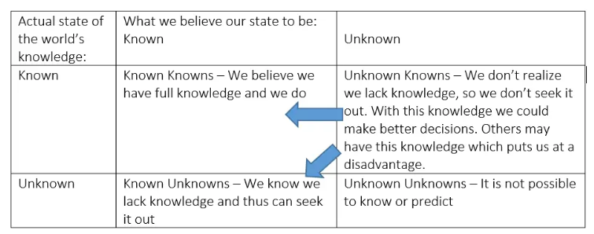
Dealing with Imposter Syndrome
Here’s my take:
Imposter syndrome is your body’s own way of keeping you grounded
It opens you up to new knowledge, approaches, techniques and approaches
Rumsfold’s Known Unknowns

Slide 11
Dealing with Imposter Syndrome
Here’s my take:
When you start a new skill, you simply don’t know what you don’t know
You just don’t have the insight, you haven’t had enough experience in the skill domain
It’s extremely easy to over-estimate your skills (as you have absolutely no idea of what constitutes ‘good’ or even ‘competent’)
As highly directed and motivated undergraduates, you’re probably putting a lot of effort into your pathway
You may well have forgotten what it’s like to learn new skills from scratch and how much you suck at them and how good you think you are
Go learn to play an instrument, dance, learn a new language etc to see what sucking it really like

Slide 12
Dealing with Imposter Syndrome
Here’s my take:
As you start to develop expertise in a field, you start to realise just how big / hard / demanding that field is
You start to know what you don’t know
You appreciate the enormity of the field -> imposter syndrome
At this point, you do a lot of creative practice and a lot of it will suck
That’s good, you are seriously developing your skills
Over time, the ratio of suck to not-suck will favour not-suck

Slide 13
Dealing with Imposter Syndrome
Here’s my take:
Gladwell’s 10,000 hours of deliberate practice
In Outliers, Gladwell presents an argument that it takes around 10,000 hours to get good at something
Uni Study is often 30 hours/week over 30 weeks/year
900 hours/ year -> 11 years to get good
Work is 40 hours/week * 46 weeks/year
1800 hours/year -> 5.5 years to get good
Of course, not all work is created equal
10 years of making normal maps will not make you a fully capable artist.
http://graphics8.nytimes.com/images/blogs/freakonomics/pdf/DeliberatePractice%28PsychologicalReview%29.pdf

Slide 14
Dealing with Imposter Syndrome
Here’s my take:
Gladwell’s 10,000 hours of deliberate practice
Gladwell’s critics cite that you don’t need 10,000 hours to get good
And you might never get good
v.Bad
>10,000hrs
Average
About 10,000hrs
v.Good
<10,000hrs
https://www.fastcompany.com/3027564/scientists-debunk-the-myth-that-10000-hours-of-practice-makes-you-an-expert

Slide 15
Dealing with Imposter Syndrome
Here’s my take:
Gladwell’s 10,000 hours of deliberate practice
Gladwell’s critics cite that you don’t need 10,000 hours to get good
And you might never get good
Though you have all got this far, so you are doing something right

Slide 16
Portfolios: what makes a good portfolio?

Slide 17
Portfolios: what makes a good portfolio?
There’s no one true definition of this, we want to look for some aspects and features

Slide 18
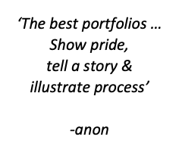
Portfolios: what makes a good portfolio?
There’s no one true definition of this, we want to look for some aspects and features

Slide 19
Portfolios: what makes a good portfolio?
From a recruiter’s position
See what candidates have done
See what their interests are
See how they organise and present their work
Often,
Portfolios will decline as developers become more experienced
Products show better what you have done
NDAs make it difficult to talk about what you’ve done

Slide 20
Portfolios: what makes a good portfolio?
https://www.youtube.com/watch?v=0j9MSWTtmE0

Slide 21
Portfolios: what makes a good portfolio?
From a recruiter’s position
See what candidates have done
Game development is generally team-based
We want to have something to talk to you about your experiences of working in groups
We expect academic teamwork to be a dumpster fire
Good to find out how you cope with those issues

Slide 22
Portfolios: what makes a good portfolio?
From a recruiter’s position
See what their interests are
Often your ‘nerdy’ interests may be extremely useful for a company
Trainspotter -> dovertail games (https://dovetailgames.com/)
Footie stat nerds -> champman games
Footie nerds -> all the football games
Fishing nerds -> all the fishing games
Farm nerds -> all the farming FPS games
Car nerds -> all the car racing games
Gun / Tank / Plane / Ship nerds -> World of Tanks etc
D&D nerds -> So many games and studios you would not believe
Distopian nightmares -> Lucas Pope
https://scarfolk.blogspot.com/ -> Richard Littler
Dynamic comic books -> Telltale games
Politics -> Democracy www.cliffski.com
Interior design, city modelling etc
Cultural fit
Cosplay may be a highly desirable skill to have for a particular employer

Slide 23
Portfolios: what makes a good portfolio?
From a recruiter’s position
See how they organise and present their work
Visual language (particularly for artists / designers)
Approach to writing (clarity, grammar, spelling etc)
Can you get ideas (complex or otherwise) across to other people?
Not just for writers, but for anyone that could end up writing in some manner:
Technical writers, evangelists, support, QA etc

Slide 24
Portfolios: what makes a good portfolio?
From a recruiter’s position
Use as a broad cut for candidates
Is there some alignment between what a candidate is showing and what we are looking for?
Use to drive interview questions
Talk about what the candidate has done
Really good way to get them talking about things they are enthusiastic about

Slide 25
Portfolios: what makes a good portfolio?
‘The best portfolios show pride, tell a story & illustrate a process’
A portfolio isn’t just a collection of work
That’s a slideshow
You need to curate what you are going to present
Choose work that you are proud of
Choose work that means something
If you want to do X, then look for work that demonstrates X

Slide 26
Portfolios: what makes a good portfolio?
‘The best portfolios show pride, tell a story & illustrate a process’
Tell a story
Curation is often about telling stories that are not verbal
Maybe you want to show how you have developed your craft over the three years of the course
Maybe you want to show how you’ve managed to make better games over that time
Maybe you want to show how your interests have changed over that time

Slide 27
Portfolios: what makes a good portfolio?
‘The best portfolios show pride, tell a story & illustrate a process’
Illustrate a process
How do you ‘do’ work
Show the lifespan of a project, from ideation to blockout, from blockout to refinement and refinement to polish
How do you spot and address defects
This can be presented however you see fit, depending on the nature of the work and how you want to describe it
Blogs, videos, images etc

Slide 28
Portfolios: what makes a good portfolio?
‘Smart & gets things done’ (Joel Spolsky)
This is from a book on technical recruitment, but it’s relevant to all routes
Smart
Do you work smart or dumb?
Are you looking for ingenious approaches to address your workflows and/or problems
If you find meaningful solutions, you should talk about them (blogs, videos, tutorials etc)

Slide 29
Portfolios: what makes a good portfolio?
‘Smart & gets things done’ (Joel Spolsky)
This is from a book on technical recruitment, but it’s relevant to all routes
Gets things done
Do you talk a good process or do you actually get things done
People (recruiters) love seeing concrete examples of things
Jazzhands <roles> are not good recruits
Don’t talk about things you ‘totally could do’, just go and do them instead
Ideas are a dime a dozen, execution is hard

Slide 30
Portfolios: what makes a good portfolio?
‘Smart & gets things done’ (Joel Spolsky)
This is from a book on technical recruitment, but it’s relevant to all routes
Both smart and gets things done tend to occur together
You’re thinking about your role and how you can do interesting things
That is a very employable skill.

Slide 31
Portfolios: what makes a good portfolio?
(Back to) From a recruiter’s position
Use to drive interview questions
Typically
Creative / Professional Practice:
‘Tell me about how you did X on your project’
‘What was the most challenging problem you addressed on your course’
Team Dynamics
‘How did you work in teams’
‘How did you deal with conflict’

Slide 32
Portfolios: what makes a good portfolio?
Creative / Professional Practice (Bad response)
I just made artwork and gave it to the programmers on a usb stick

Slide 33
Portfolios: what makes a good portfolio?
Creative / Professional Practice (Good response)
First, we needed to work out what the technical art guidelines so I sat down with the programmer to work them out. It took a couple of goes to get it right, so I blogged about it as it was an interesting process.
As an art team, we made an asset kit but we wanted to make sure we could model everything we wanted, so we did some concept sketches of the buildings we wanted and then greyboxed the kit pieces and worked out how we could build shared texture atlases that could be used across all the kit pieces to reduce the material count. We developed an approach based on placeholder atlases, I have some screenshots of that on my portfolio to show how the process worked ….

Slide 34
Portfolios: what makes a good portfolio?
Creative / Professional Practice (Bad response)
I told the programmers what the game design was and told them what to fix after they had written it. There were a lot of issues, I don’t think they had been listening when I explained it to them.

Slide 35
Portfolios: what makes a good portfolio?
Creative / Professional Practice (Good response)
We (the designers) paper prototyped the game originally. I’ve got a video that shows us playing the prototype and there’s a blog piece on what worked well.
Next we spent a day making a prototype in GameMaker so the programmers could see how things worked. We put the prototype online so we could all play the game. As the programmers implemented the prototype in Unity, they exposed balance data so we (designers) could experiment more with the game.

Slide 36
Portfolio analysis

Slide 37
Portfolio analysis
Disclaimer
These are (generally) all portfolios from last years’ students and were assessed on different criteria to this year

Slide 38
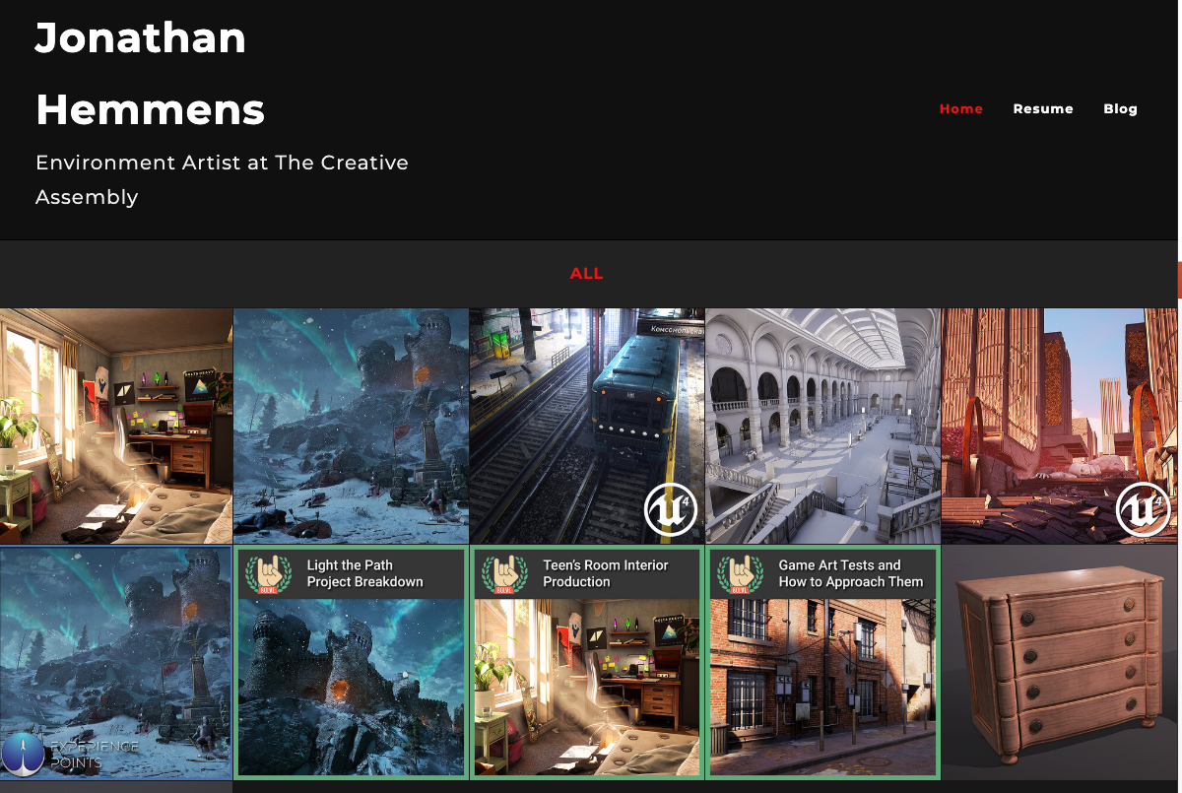
Jonathan Hemmes (Art)
https://jonjo.artstation.com/

Slide 39
Jonathan Hemmes (Art)
https://jonjo.artstation.com/
Artstation provides a nice context for artwork
Jonathan has provided ‘enough’ content to give the impression of someone that is getting stuff done
& it looks like it’s high quality
There’s a general theme in the portfolio
It’s all environment
It’s not environment, character, hard surface , props and so on
There’s clearly different environments
They all share a broadly similar art style
It’s all realistic
Assets are well laid out and the thumbnails look quality
From the front page we can get a clear idea of what Jonarthan’s interests are
And his expertise

Slide 40
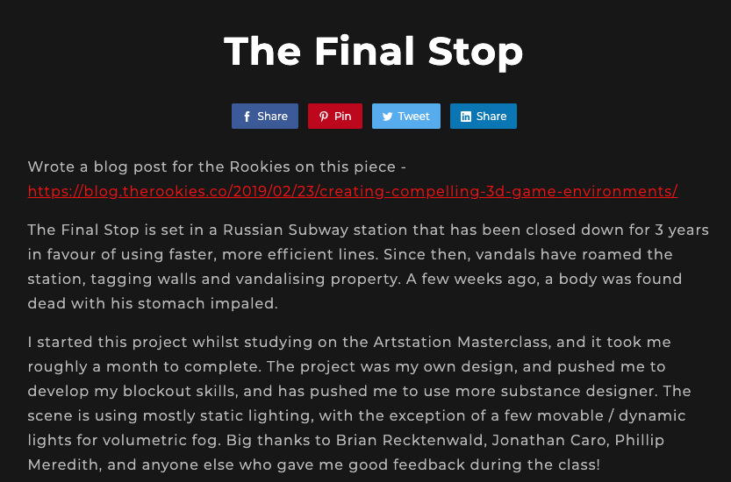
Jonathan Hemmes (Art)
https://jonjo.artstation.com/

Slide 41
Jonathan Hemmes (Art)
https://jonjo.artstation.com/
Each piece has some context
What is this piece supposed to be about
Description of why the piece exists:
Develop my blockout skills
Use substance designer
Static lighting
Description of process
Including feedback

Slide 42
Jonathan Hemmes (Art)
https://jonjo.artstation.com/
https://discover.therookies.co/2019/02/23/creating-compelling-3d-game-environments/
There’s a blog about how the piece was made
Very self-reflective
Reference sheet

Slide 43
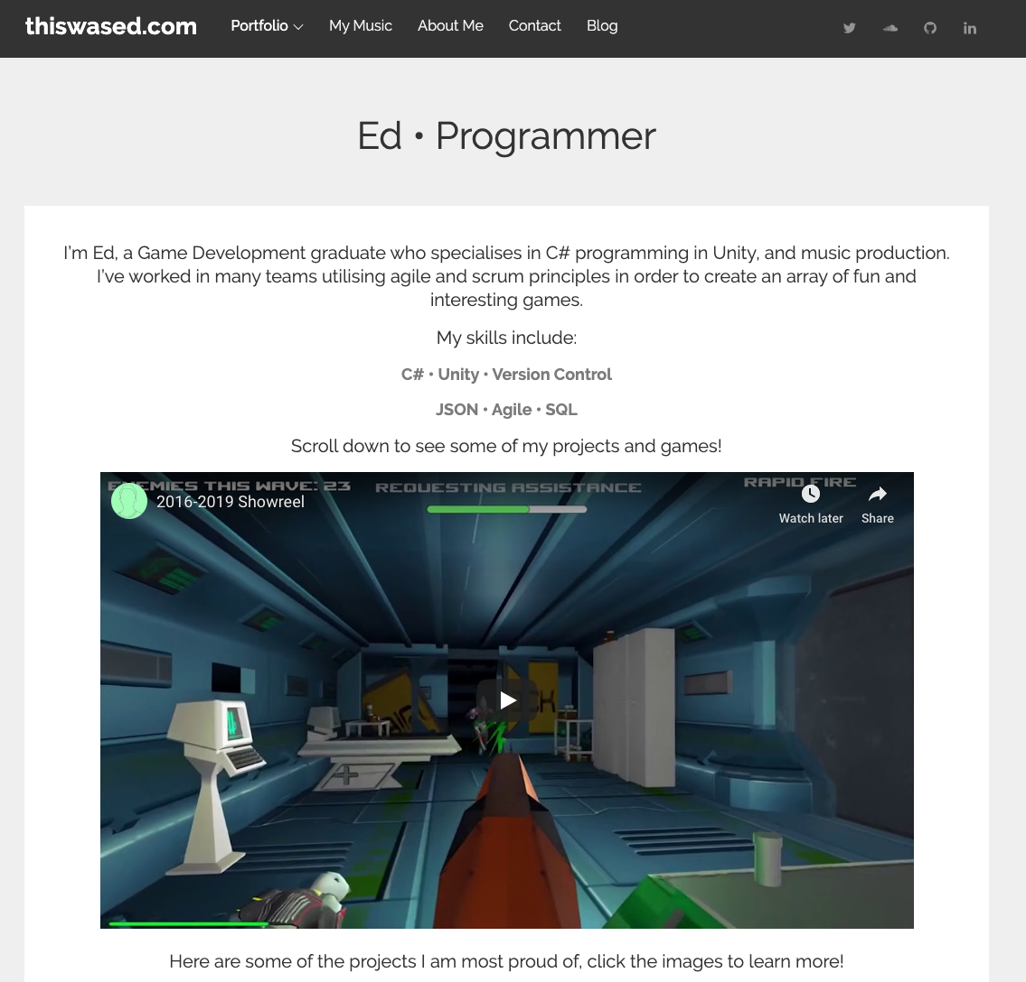
Ed Rowe (Programming)
https://thiswased.com/

Slide 44
Ed Rowe (Programming)
https://thiswased.com/
Hand-built website
Don’t have to do this by any stretch of the imagination, but for those that want to work in web, it can be useful
Off-the-shelf websites are also fine
This is different and similar to Jonathan’s
Collection of work that has been thoughtfully laid out and has some info

Slide 45
Ed Rowe (Programming)
https://thiswased.com/
Showreel
https://youtu.be/alVEFXTBQR0
Personally,
I think this is nice to add
It’s a bit on the long side
Each sequence could do with an explanation to say what it is, Ed’s role and why it’s on the show reel
You don’t want people thinking your ‘first year game jams’ are your final year projects
Consider having a v/o like a directors commentary saying what things are

Slide 46
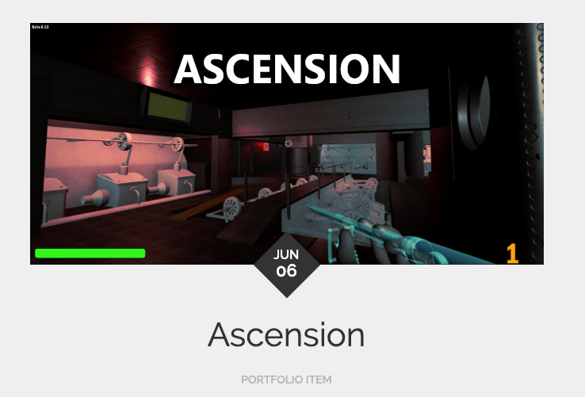
Ed Rowe (Programming)
https://thiswased.com/
Ascension
Ed’s second year group project
I thought this was really nice when Ed and his team were working on it
10 player FPS on Unity
Ed wrote the networking components
This is really impressive and Ed should make a lot more of it
Like a blog or something (see what Jonathan did)
He’s just written a paragraph about timers ☹

Slide 47
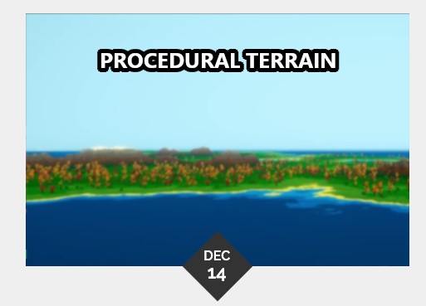
Ed Rowe (Programming)
https://thiswased.com/
PCG project
I particularly like this
1. Interesting project
2. Good outcome
3. Interesting process
I think there’s a lot more Ed could blog about, if he was that interested in the project

Slide 48
Ed Rowe (Programming)
https://thiswased.com/
PCG project
I particularly like this
1. Interesting project
2. Good outcome
3. Interesting process
I think there’s a lot more Ed could blog about, if he was that interested in the project
For example, an academic I know (twitter) did something similar over the summer and posted a lot about what they were up to

Slide 49
Ed Rowe (Programming)
https://thiswased.com/
In summary
Generally, I thought this was a good technical portfolio
Shows that Ed is smart
PCG
Networking
Shows that Ed gets things done
PCG demo
Networking game
Other games

Slide 50
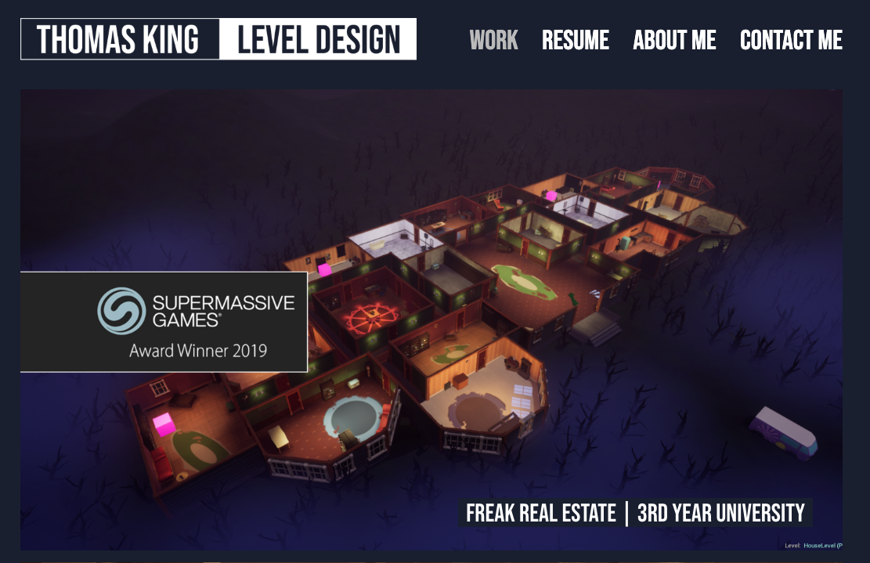
Tom King (Design)
https://www.thomaskingleveldesign.com
Hand-built website

Slide 51
Tom King (Design)
https://www.thomaskingleveldesign.com
Site from Squarespace (I think)
Nice presentation (as I would expect from designers)
Really nice level design exposition within some of the projects
3rd year project descriptions are TBD (2019 ;)
https://www.thomaskingleveldesign.com/a-new-tomorrow

Slide 52
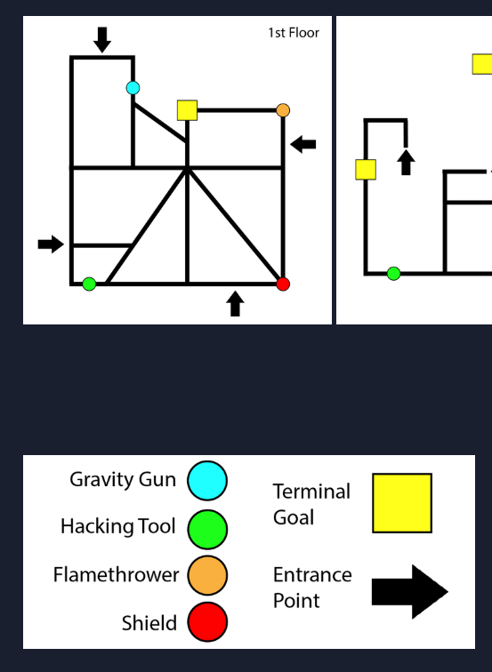
Tom King (Design)
https://www.thomaskingleveldesign.com
Game breakdowns
Show a level design process
a design philosophy
Why game design choices were taken
A post-mortem
A bit of reflection

Slide 53
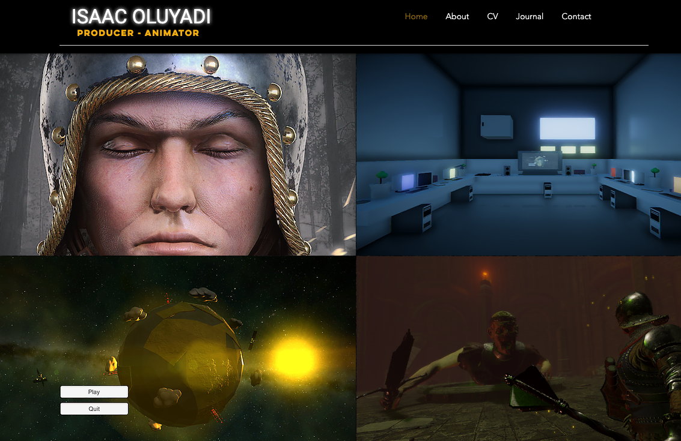
Isaac Oluyadi (Animator / Producer)
https://ioluyadi.wixsite.com/website
Game breakdowns
Show a level design process
a design philosophy
Why game design choices were taken
A post-mortem
A bit of reflection

Slide 54
Isaac Oluyadi (Animator / Producer)
https://ioluyadi.wixsite.com/website
Site from wix
This is a bit more interesting as Isaac is taking a producer role within projects
Nice selection of images on home page

Slide 55
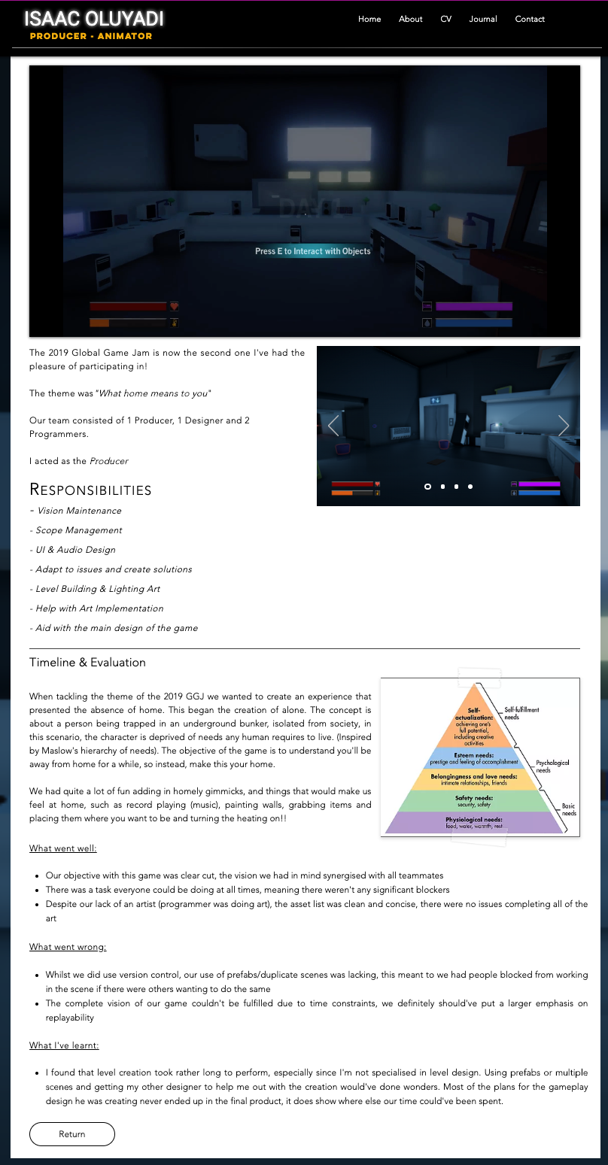
Isaac Oluyadi (Animator / Producer)
https://ioluyadi.wixsite.com/website
Reflection & post-mortems
Each project has some feedback which is good to see
As a fledging producer, Isaac needs to ‘walk the talk’ both in terms of:
What he’s doing on a project as a producer
Why he’s doing what he’s doing

Slide 56
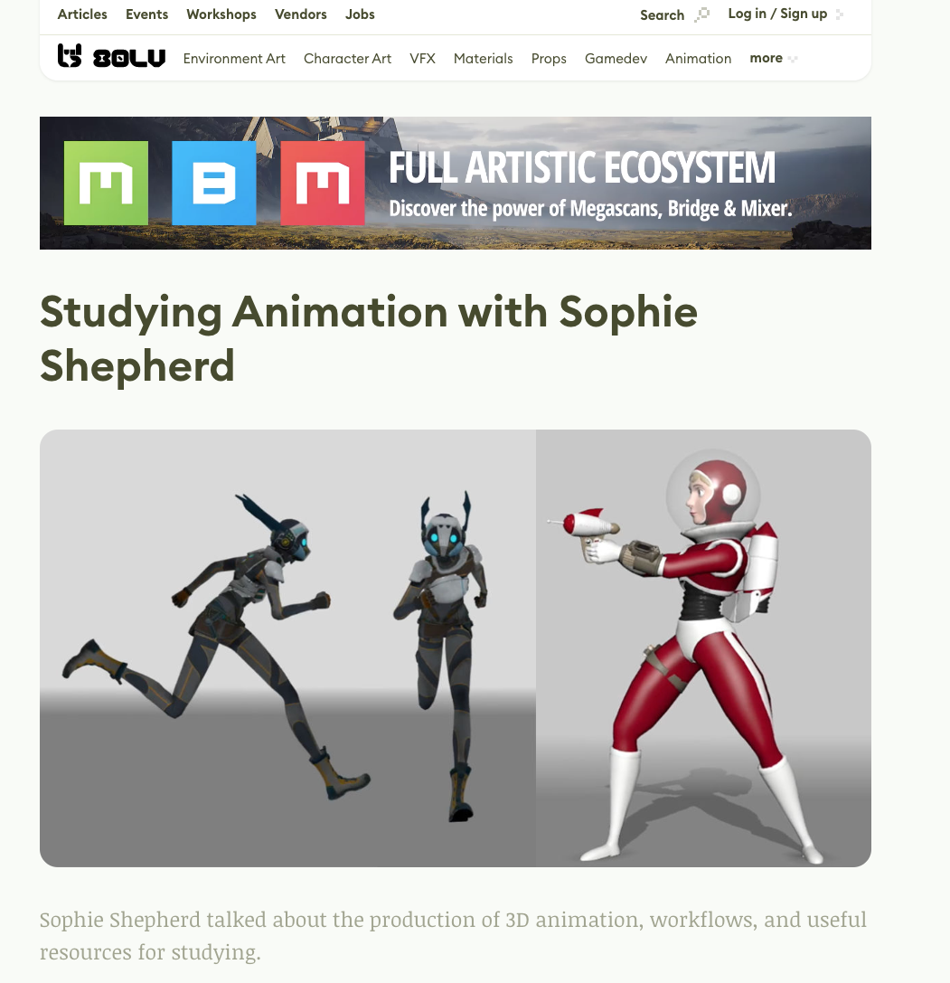
Sophie Shepherd(Animator)
https://80.lv/articles/004adk-studying-animation-with-sophie-shepherd/
Workshop
I couldn’t find a portfolio for Sophie
I think it’s expired
However, the howto guide is very nice to follow and works well as a portfolio piece to show expertise

Slide 57
Hannah’s Writer (Writer)
TBD – don’t fail me Hannah!

Slide 58
Portfolio wash-up
We can see there isn’t a one size fits all approach for portfolios
It depends on your role and what you are looking for in work
However, there’s some common themes
Content
Context
Narrative

Slide 59
Portfolio wash-up
None of these portfolios are perfect
There’s always something you can polish / refine / refactor
They are easily good enough for job hunting

Slide 60
Portfolio wash-up
Your challenge(s)
Work out what you fancy doing career-wise
Look to curate (existing work) and create (new work) that helps to showcase your skills and talents
Provide meaningful narratives that explain your content, curation and process(es)
If you are shifting roles (production / S&M)
Look to create some real think pieces on what you are doing
Maybe look to bridge across games
Games production
Games marketing
As you get to draw from your experience (games)

Slide 61
Questions

